Slide 1
Ajit Singh – 4y – Data Scientist

Slide 2
Initialize a list of ten random numbers and print the maximum number.
With and without using built-ins

Slide 3
Find a number in a given list of ten numbers.
Return the index of the number if it is there otherwise return false.

Slide 4
Binary Search
Forgot
Studied long back when he was doing preparation for DSA

Slide 5
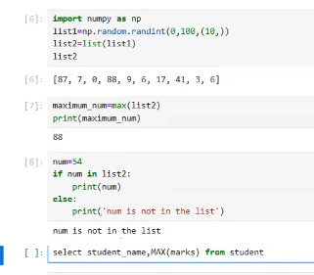
SQL: find the student with highest marks
TABLE: <name, marks>
Incorrect

Slide 6
SQL: Find the student with the second highest marks
Find the student with the second highest marks in the table <name, marks>

Slide 7
SQL
Table: <name, section, marks, result(pass/fail)>
Report: <section, pass_count, fail_count>

Slide 8
Search
Not on tips
Need to revise

Slide 9
Sorting
Need to revise

Slide 10
Student with highest marks
Correct

Slide 11
Student with second highest marks
25% correct

Slide 12
STUDENT TABLE AND PASS/FAIL REPORT
TABLE SCHEMA: <name, marks, result, section>
REPORT SCHEMA: <section, pass_count, fail_count>
INCORRECT

Slide 13
What all ML algorithms have you used?
Linear Regression
Logistic Regression
ARIMA/SARIMA
What are the assumptions of Linear Regression?
What all cost functions can be used with Linear Regression?
What do we optimize in Linear Regression algorithm?
What are the assumptions of Logistic Regression?

